Slide 1



FINANCIAL LITERACY PROGRAM
BUILDING SOUND FINANCIAL MANAGEMENT SKILLS
MODULE 6
MODULE 11
Markets and Investment Vehicles
Charles Nowochin
October 2020
Notes:
Thank you for coming today.
My name is Charles Nowochin and I am an advisor with RBC Dominion Securities

Slide 2



Program Overview
1
EARNINGS & SAVINGS
1. Budgeting
Money
2. Income &
Taxation
3. Banking
Services
3
4. Interest
9. Financial Documentation
INVESTING
10. Asset
Classes
11. Markets & Investment Vehicles
12. Risk & Diversification
18. Charitable
Giving
19. Trusts
20. Wealth
Transfer
RBC Wealth Management’s FINANCIAL LITERACY PROGRAM
13. Risk Tolerance Profile
4
5. Credit
8. Wealth
Stage
Plans
17. Insurance
16. Wills &
Estates
ADVANCED PLANNING
15. Understanding
Fees
14. Building a
Portfolio
2
7. Planning
Benefits
WEALTH
PLANNING
BASICS
6. Account
Types
Notes:
At RBC Wealth Management, we understand that financial concepts can be difficult to understand and we are committed to helping families make sense of wealth and money.
Suitable for individuals of any generation, whether it be Seniors, Baby Boomers, Generation Xers or Millennials, we have built a financial literacy education program to help individuals be successful in managing their money and their finances.
OR
Suitable for individuals of any generation, whether it be Seniors, Baby Boomers, Generation Xers or Millennials, we have built a financial literacy education program to help individuals take charge of their finances and feel confident in meeting their financial goals.
Our program is broken down into 4 components, each with modules designed to build financial literacy in the areas of:
Earnings & Savings
Wealth Planning Basics
Investing
Advanced Planning
Today, we move one step further towards becoming proficient in understanding key ‘Investing’ concepts as we focus on Markets and Investment Vehicles, module #11.
OR
In today’s ‘Investing’ lesson, we will focus on Markets and Investment Vehicles, designed to explain how the interactions amongst various market participants (e.g. buyers, sellers, and financial intermediaries) create marketable securities as a result of those transactions.

Slide 3

Today’s Agenda
PART 1 | Classification of Financial Markets
PART 2 | The Role of Capital Markets
PART 3 | Understanding Financial Marketplaces Group Exercise – Reading Quotes
PART 4 | Measuring the Market – Indices
PART 5 | Measuring the Market – Sectors
PART 6 | Investment Vehicles
APPENDICES | Key Terminology – Investment Funds
Notes:
We are going to look at the various parts of the financial markets and how they are categorized by:
the shelf life of a specific investment e.g. stocks and bonds; and
how and where stocks and bonds are traded on the secondary market.
We will also look at:
a key component of the financial markets, the capital markets, to understand how governments and corporations gain access to long term financing.
how financial market activity can be measured through indices and sectors.
And finally, we will connect the concepts of financial markets with investment vehicles, specifically Mutual Funds, Index Funds, Exchange Traded Funds (ETFs), and Segregated Funds.
Our goal by the end of today, is to ensure you leave with a better understanding of financial markets and trading, as well as the investment products or vehicles that investors use to build portfolios.
I encourage you to contact me after this lesson with any questions you may have and will share my contact information at the end of the lesson.
So let’s get started.

Slide 4








Classification of Financial Markets
PART 1
2 KEY WAYS to CATAGORIZE FINANCIAL MARKETS
FINANCIAL MARKETS
BASED ON MATURITY STRUCTURE
BASED ON TRADING STRUCTURE
Money Markets
Capital Markets
Primary Markets
Secondary Markets
Short Term –Treasury Bills
Long Term – Stocks and Bonds
Newly Issued Securities
Outstanding Securities
Notes:
Previously in module 10, you learned about the primary asset classes of stocks (equities), bonds (fixed income), and cash.
OR
There are three primary asset classes: stocks (equities), bonds (fixed income), and cash.
A key objective for today is to explore the origins of stocks and bonds, the role they play in the economy, and finally how stocks and bonds can be packaged as mutual funds and exchange traded funds for further sale to investors.
To achieve this objective, we first need to step back and examine the role of the financial markets.
We break the financial markets down into two structures:
Those based on maturities (e.g. short term t-bills or long term stocks and bonds); and
Those based on trading (e.g. newly issued or outstanding securities).

Slide 5
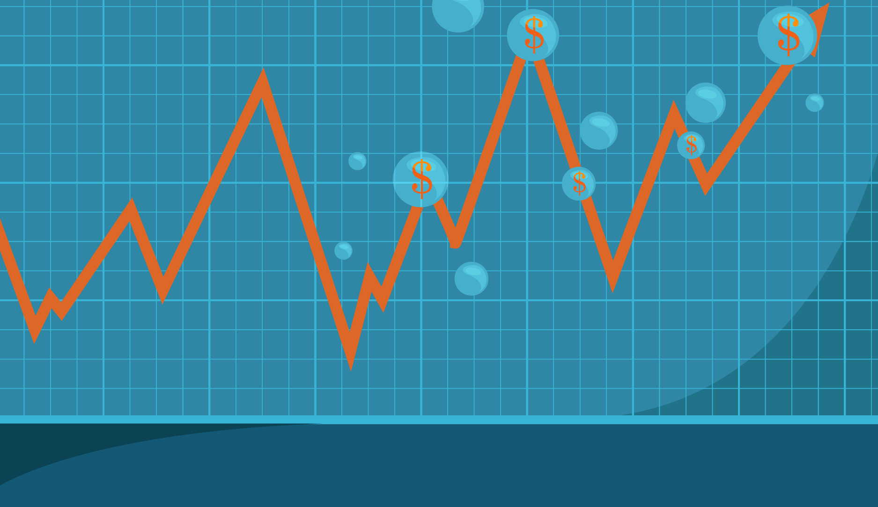




Classification of Financial Markets
PART 1
FINANCIAL MARKETS
MONEY MARKETS
CAPITAL MARKETS
Primary Markets
Secondary Markets
Financial Exchanges
Over-The-Counter
Notes:
What do all these terms mean?
Financial markets refers to the broad set of rules and systems that are in place so that financial transactions can happen easily, legally, and with predictability among buyers and sellers of financial instruments.
Within the financial markets, we have markets that are differentiated based on the maturity of the investment vehicle being traded.
Money market refers to financial transactions of investment vehicles that have a maturity of 1 year or less (e.g. Government treasury bills).
Capital market refers to financial transactions between buyers and sellers for investments that have a maturity of greater than 1 year (e.g. stocks and bonds).
Because the capital markets are the source of the majority of stocks and bonds that are used to build investment portfolios, we are going to focus our attention here.
When a corporation or the government issues a new stock or bond directly to the public to raise capital, this happens in the primary market.
The corporation or the government is the issuer.
When an existing security changes hands between individual investors, this happens in the secondary market.
Most capital market activity happens in the secondary market.
Unlike the primary market, transactions in the secondary market do not involve the issuer.
Within the secondary market, security transactions happen in 2 arenas:
Financial exchanges (commonly referred to as stock markets) are where equities are traded; and
Over-the-counter markets are the primary method for bond trading as well as stock transactions.
What can makes these distinctions between financial markets, capital markets, and secondary markets confusing is that the term “markets” is often used to refer to stocks exchanges like the New York Stock Exchange (NYSE on Wall Street in the US), the Toronto Stock Exchange (TSX on Bay Street in Canada), or simply when talking about bond or stock markets in general.

Slide 6




The Role of Capital Markets
PART 2
Governments and businesses raise money by selling newly issued securities to buyers.
SECONDARY MARKETS (aka Aftermarket)
PRIMARY MARKETS
Financial Intermediaries
Enables the buying and selling of previously issued securities.
Notes:
There are three primary participants in the capital markets.
This first participant are the Financial Intermediaries:
Financial intermediaries act as the middleperson or the institution facilitating the transactions that move funds between buyers and sellers.
They act as the connection point so that the parties on either side of the transaction do not actually ever have to meet.
Financial intermediaries can provide specialized services by transforming assets and liabilities into other forms to help participants reduce risk or lower their costs.
Examples include commercial banks, investment banks, brokerage firms, mutual funds, pension plans and insurance companies.

Slide 7

The Role of Capital Markets
PART 2
DEBT MARKET
Trading of Bonds
SELLERS
Sell assets to raise funds for financing
CAPITAL MARKETS
Financial Intermediaries
BUYERS
Invest in assets to generate –returns
EQUITY MARKET
Trading of Stocks
Notes:
Buyers and sellers are the other two participants within capital markets.
Sellers – are the borrowers or issuers who want to use the capital markets to generate financing through the issuance of stocks and bonds.
Sellers include governments at the municipal, provincial and federal level, as well as corporations.
Buyers – are investors who have cash and want to invest generate a return.
Buyers include individual retail investors like you and I, institutional investors such as pension plans, investment funds, governments, non-profit organizations and banks, and other financial institutions such as life insurance companies and credit unions.
The role of the capital markets is to channel savings and investments between suppliers of capital (e.g. individual investors) and institutional investors and users of capital like businesses, government and individuals.
Institutional Investors are non-bank persons or organizations that trade securities in large enough quantities or dollar amounts that they qualify for preferential treatment and lower commissions.
Examples of institutional investors include pension funds and life insurance companies.
Capital markets are vital to the functioning of an economy, since capital is a critical component in generating economic output.
The size of a nation’s capital markets is closely related to the size of it’s economy.

Slide 8












The Role of Capital Markets
PART 2
MONEY RAISED THROUGH ISSUING SHARES BY SECTOR
FUNDING INNOVATION AND GROWTH
Start-ups and mature companies use capital markets to fund growth, to attract new or a more diverse set of investors, to hedge their risk, or to generate a return on investment.
MONEY RAISED THROUGH GOVERNMENT ISSUING DEBT
CAPITAL MARKETS
FUNDING THE NEEDS OF COMMUNITIES
Municipalities raise funds to build critical infrastructure, such as airports, bridges, libraries, roads and schools, to support communities.
Notes:
Once financing has been raised through the capital markets, governments can use the proceeds to pay the interest on existing debt, fund social programs, maintain facilities, and sponsor infrastructure projects such as roads, hospitals, airports, and schools.
Corporations use capital markets proceeds to sustain existing operations and expand their businesses by upgrading equipment and hiring personnel to allow increased operational capacity and/or capture a larger market share thereby generating more revenue.
When a business generates more money, the change is usually reflected in a higher stock price.
Hence ,investors are motivated to buy stocks of companies that have brighter economic prospects.
Without the capital markets for bonds and stocks, governments and businesses would have fewer options to implement their policies or to bring innovative ideas to market.
Capital market participants looking to borrow would have to either raise taxes, sell off assets, or save up enough money to re-invest.
With healthy capital markets, governments and businesses can obtain the needed financial support to build healthy communities and profitable companies.
They can also expand existing businesses to create new jobs which in turn help strengthen the overall economy.

Slide 9
The Role of Capital Markets
PART 2
BOND MARKETS
STOCK MARKETS
Global Bond Market Outstanding 2018 – $102.76 Trillion
Global Equity Market Capitalization 2018– $76.69 Trillion
Much larger market than the equity markets.
Segmented by government and corporate issuers.
Segmented by credit quality and maturity.
Governments and corporation can have many bonds in the market at once.
The stock market is the market typically being referred to when people talk about the markets in general.
Segmented by region, country, and company size.
Unlike bonds, corporations typically only have one stock associated with their company.
Source: Bank of International Settlement (BIS)
Note: Market capitalization of listed domestic companies Source: World Federation of Exchanges
Notes:
Now that we’ve covered the introduction to capital markets, let’s take a closer look at how the capital markets for bonds and stocks differ.
In terms of size, you might be surprised to learn that the bond market is much larger than the stock market.
So what accounts for the difference in size?
Governments and quasi government organizations cannot raise equity. Instead, they have free access to the debt markets. As a result, a large part of the debt markets are government issued securities. In fact, The U.S. Treasury is the largest issuer of bonds worldwide. In the U.S. and Canada, bonds issued by the federal government are backed by the full faith and credit of the government. This makes government debt instruments attractive investments because investors perceive them to be risk free and highly liquid.
Instead of taking out a loan, corporations have two options when it comes to raising financing - issuing bonds or stocks. Issuing bonds does not dilute the shareholder base and allows management and majority shareholders to retain control of the company.
Interest deductibility may allow corporations to deduct the interest payments made to bondholders on their corporate income tax return. This in turn could reduce the overall tax liability of the corporation. In comparison, when you sell stock, the proceeds are taxed as income. The corporation is further taxed on the dividends paid to your shareholders.

Slide 10
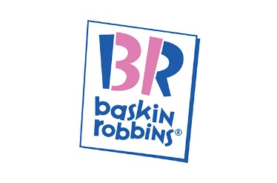














Understanding Financial Marketplaces
PART 3
Specific
Bricks and Mortar
Online / Electronic
General
Notes:
In the next section, we are going to focus our attention on financial marketplaces where stock and bond transactions occur.
The financial market concept is one we should all be familiar with since buying and selling has been part of human existence since the dawn of time.
Buyers and sellers needed somewhere to meet in order to display their goods and services, entice buyers, negotiate prices, and conduct transactions.
Using some of today’s most iconic brands as examples, we see from this market matrix that retailers and exchanges exist in multiple dimensions.
Looking at the horizontal axis, we can see that the way we purchase a good or service will vary by distribution channel, and along the vertical axis, the type of good or service can be very specific or general in nature.
Let’s walk through a quick example: CLICK TO HIGHLIGHT IMAGES
Assume it is a hot day and you want to treat yourself to an ice cream cone from Baskin Robbins. Most likely, you would walk or drive to your local ice cream emporium (bricks and mortar) and order your favourite flavour or feature of the month (a very specific selection). This type of exchange or transaction would happen in the upper left hand quadrant.
Conversely, when shopping at the local Walmart (bricks and mortar) for a few household items, by the time you are done, you might end up leaving with garbage bags, laundry detergent, toothpaste, groceries, a magazine, and a video game (general products) .... an exchange typified by the lower left hand quadrant.
While these examples are not hard and fast rules to be followed, they illustrate the clear intersection point between the distribution channel and the product.
However, in today’s quickly evolving digital world, it is not uncommon for retailers to generate sales through both online and physical store fronts (e.g. in a mall).

Slide 11




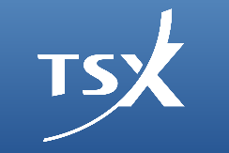





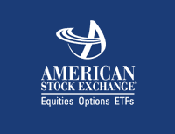
Understanding Financial Marketplaces
PART 3
Bond
Financial Exchange
Over the Counter (OTC)
Stock
Notes:
Using this same analogy, marketplaces have different forms of distribution channels for the goods and services which are exchanging hands in the financial markets (e.g. stocks, bonds, and currencies).
You’ll notice on the horizontal axis, we make reference to the distinction between financial exchanges – typically referred to as stock exchanges or markets and the Over-the-Counter markets – typically referred to as the OTC market or bond exchange.
These are the two basic ways markets are organized…although again, with the introduction of electronic / online trading, financial intermediaries are beginning to blur the lines on how these transactions take place.

Slide 12







Understanding Financial Exchanges
PART 3
OVER-THE-COUNTER (OTC)
FINANCIAL EXCHANGE
Exchange Traded Funds (ETFs)
Bonds
Broker A
Customer A
Common Stock (Shares)
Broker B
Customer B
Preferred Stock (Shares)
Options and Futures (Derivatives)
Money Market Products
Notes:
Bonds and other fixed income instruments (e.g. money market products) only trade OTC, while stocks (e.g. preferred and common stock) can be traded either on a financial exchange or via the OTC markets.
In addition to stocks, Exchange Traded Funds (ETFs), and Options and Futures – also known as Derivatives – trade through financial exchanges.
ETFs will be discussed towards the end of today’s lesson, but we will not be focusing on Options or Futures.
So, how do these 2 methods differ?
CLICK TO ADVANCE NEW IMAGES
Financial Exchanges
A financial exchange centralizes the communication of bid (buy) and ask (sell or offer) prices to all market participants, who can respond by selling or buying at one of the quotes or by replying with a different quote.
Depending on the exchange, the medium of communication can be voice, hand signal, electronic message, or computer-generated electronic command.
Multiple participants are involved in these exchanges, and when two parties reach agreement, the price at which the transaction is executed is communicated throughout the overall market, to all participants.
This results in a level playing field that allows any investor to buy as low or sell as high as anyone else, as long as the trader follows exchange rules.
Over the Counter Markets
Unlike exchanges, OTC markets have never been a “place.”
They are less formal, although often well-organized, networks of trading relationships centered around one or more dealers.
Dealers act as market makers by quoting prices at which they will sell (ask or offer) or buy (bid) to other dealers and to their clients or customers.
That does not mean they quote the same prices to other dealers as they post to customers, and they do not necessarily quote the same prices to all customers.
OTC dealers convey their bid and ask quotes and negotiate prices over the telephone, mass e-mail messages, and, increasingly, instant messaging.
The process is often enhanced through the use of electronic bulletin boards where dealers post their quotes.
Because only the two market participants directly observe the quotes or execution, others in the market are not privy to the trade.
Although the trading process is often automated, this method is not considered an exchange because it is not open to all participants equally.
In short, OTC markets are less transparent and operate with fewer rules than do centralized exchanges.

Slide 13


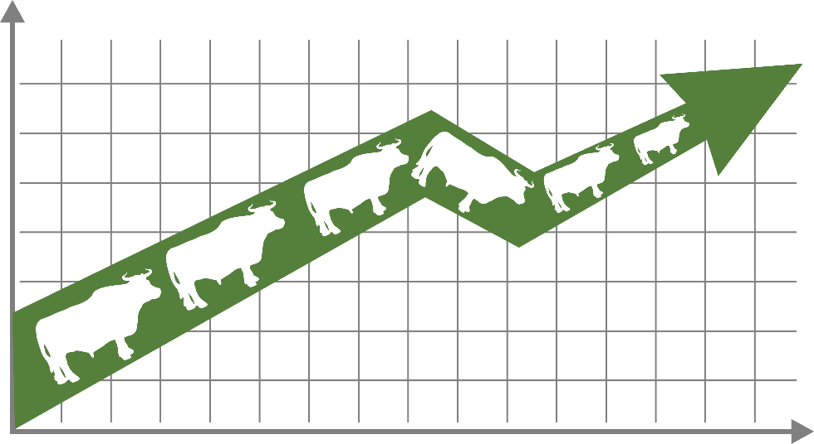
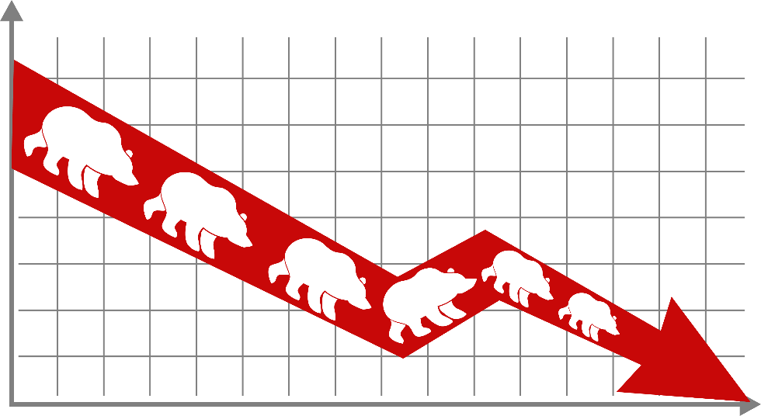
Understanding Financial Exchanges – Performance
PART 3
BULL MARKET
BEAR MARKET
Optimism
Prices going up
Pessimism
Prices going down
The terms “bull” and “bear” markets are often used to describe how financial exchanges are performing – whether they are advancing (going up) or retreating (declining in value).
Notes:
Because there are thousands of individual transactions happening each day on the various exchanges and over the counter markets – it is important to have a gauge of market activity.
Common euphemisms you’ll hear most often are “Bull” and “Bear” markets.
These terms can be applied to the broader markets, a particular asset class, or, at the security level.
The terms “bull" and "bear" are thought to derive from the way in which these animals attack their opponents.
Generally speaking, bulls thrust their horns up into the air, while a bear turns their head down.
These actions have been used historically as metaphors for the overall trends in the broader markets, whether that be an asset class or a particular stock price:
Market trends in positive territory (moving up) are considered a bull market because investors are buying.
Markets showing declining trends (moving down) are considered a bear market because investors are selling.

Slide 14


Understanding Financial Exchanges – Group Exercise
PART 3
Securities that are not bought and sold on a financial exchange are said to trade …
A
Below the Undercover Markets
B
Secondary to the Primary Markets
C
Incognito
D
On the Over-the-Counter (OTC) Markets
ANSWER
D. On the Over-the-Counter (OTC) Markets
Notes:
ALLOW AUDIENCE A FEW MINUTES TO READ QUESTION (Jeopardy music will play for 30 seconds. To stop and proceed to answer, hit ENTER.)
Jeopardy time!
Let’s test your knowledge of the Market.
Securities that are not bought and sold on a financial exchange are said to trade …
Below the Undercover Markets
Secondary to the Primary Markets
Incognito
On the Over-the-Counter (OTC) Markets?
The answer is – D, on the Over-the-Counter (OTC) Markets.

Slide 15












Group Exercise – Reading Quotes
PART 3
How many shares traded today?
LIQUIDITY OF A BOND!
The ABCs of Bonds
CLOSING PRICE
Notes:
OPTIONAL SLIDE – FOR PRESENTERS WITH LIVE AUDIENCES ONLY.
For the next 5 minutes, we are going to do an exercise on reading financial quotes, to get familiar with how stocks and bonds are priced.
Stock and bond quotes can be found online or in the newspaper.
Using the ‘Group Exercise’ in your handout packages, take a minute to read through the first section on stock quotes.
Get familiar with the terms 52-week high and low, and today’s high and low.
Company name and the type of stock.
Ticker symbol.
Dividend per share and dividend yield.
Price/earnings ratio.
Trading volume.
Now let’s go through the quiz! PRESENTER TO REFER TO SOLUTION GUIDE PROVIDED FOR THE EXERCISE – READING STOCK QUOTES.
OPTIONAL – PRESENTER CAN WALK THROUGH THE READING A BOND QUOTE EXERCISE, OR, LEAVE IT WITH AUDIENCE AS A TAKE-AWAY.

Slide 16
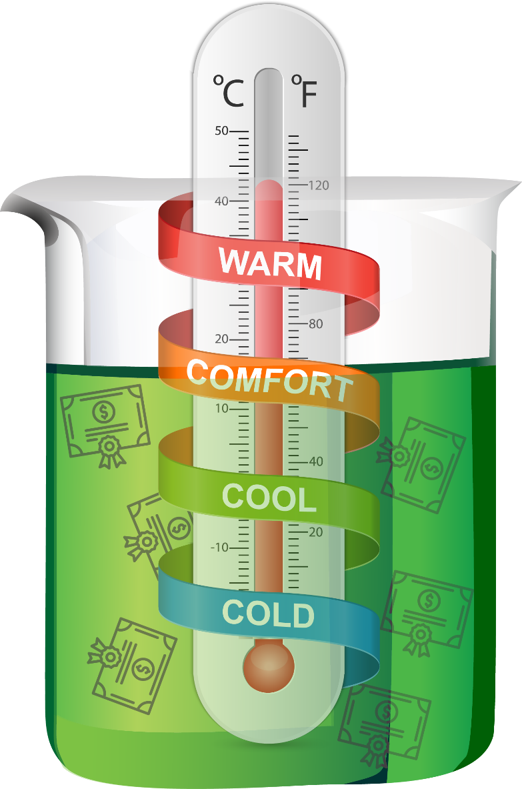

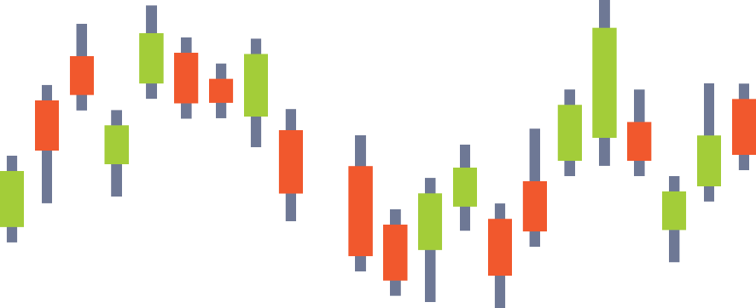
Measuring the Markets – Indices
PART 4
STOCK MARKET and BOND
INDICES
Notes:
As we learned in the previous section, financial market participants – buyers, sellers, and financial intermediaries need information about how the overall markets and their constituent investments are changing in value.
While the terms “bull and bear markets” are good at describing broad directional moves up or down, having a standardized measure that allows you to compare market activity during various points throughout the trading day is another tool investors rely heavily on.
Similar to a thermometer that measures temperature change, indices are scaled to establish a base number from which to measure units of incremental change in market activity, thereby making it easier to track changes over various time periods (e.g. minute by minute, day-to-day, or year over year).
So, just like how a healthcare professional uses a thermometer to take your temperature, market observers use a market index to assess the collective health of a group of stocks or bonds.
An index will change value as the underlying constituents change value.
For example, as business improves, indices tend to rise, and vice versa when business declines, indices tend to fall.
Data about the level of market indices are just one example of the statistics that are collected on a daily basis by financial intermediaries or other service providers to repackage for sale to interested parties such as media outlets, market participants, industry bodies, academics and governments.
OPTIONAL COMMENTARY - To learn more about the top stock market exchanges, please refer to the supplemental handout in your packages.
FOR PRESENTERS: INTERNAL LINK TO SUPPLEMENTAL HANDOUT – Top stock market exchanges and their indices: http://advisornet.fg.rbc.com/wealthmanagementservices/file-901006.pdf

Slide 17





Measuring Markets – Indices
PART 4
MARKET INDICES MAY BE CLASSIFIED IN VARIOUS WAYS
VALUE
GLOBAL
REGIONAL
NATIONAL
INDUSTRY
EXCHANGE
Includes securities from around the world, encompassing multiple regions and types of industry and sectors.
Securities that are identified by geography, e.g. Asia, Europe, Africa, Japan North America, etc.
Indices containing the securities of a specific country also known as the home exchanges.
Specialized indices tracking securities grouped by sectors of the economy e.g. Consumer Goods, Financials, Real Estate, and Utilities.
Specialized indices that may be branded by the index provider or focusing on specific attributes of various markets.
TIME
Notes:
Because financial exchanges and over-the-counter markets differ not only by
asset class (stocks and bonds),
country (Canada and US),
region (North America, Europe, Asia, Emerging Markets, etc.) and
investment style (core, growth and value),
there is a wide range of indices in existence that serve as the benchmark for these specific market segments.
Due to technological advances in communications, financial markets are fluid and interconnected, causing markets to react quickly to economic, social and political events like:
Corporate and economic reports
Acts of war and terrorism
Changes in domestic and foreign policy
Natural disasters
Sometimes the reaction is short-lived and the opposite of what market pundits had predicted.
Recent examples include the direction of interest rate announcements, election results, and trade negotiations.

Slide 18

Measuring Markets – Indices
PART 4
A variation in the price of an index is calculated in points …
but expressed as a percentage.
The ACME 100 Index is up 50 points today.
Correct! But that equates to only a 1% move.
Notes:
As the various financial markets will react in their own fashion to the events that impact them more directly, it is important to know that market indices each tell their own unique story.
Because indices mirror the history of an exchange or market, they will vary in inception dates.
For example, indices in the developed markets may have been in existence longer than indices in the developing or emerging markets.
Indices also reflect the composition of the underlying economy of a country of region.
As a result, they will also vary in the type of economic activity that is being measured.
For example, on a relative basis, Canada has a greater percentage of its economy dependent upon energy and natural resources than the United States.
As you begin to follow the markets, over time you’ll develop a broader sense for:
The normal range of activity for an underlying index.
Given the volatility differences in asset classes, the movement in a bond index may be more subdued than a stock index within the same country.
For example, a large-capital index should be less volatile than its corresponding small-capital index.
Whether or not the index is based on market capitalization or price change.
Which companies are in high demand and what industries are falling out of demand.
For example, are technology companies overtaking consumer goods companies as drivers of growth?
Regardless of the index, is very important to put the change in market activity in proper context.
While a variation in the price of an index is calculated in points … the variation should be expressed as a percentage to provide a better sense of the magnitude of the change.
On the surface, the closing level of the index or the point change may seem large.
However, it is not unusual for a large daily rally or decline in the indices to make headlines.
When this happens, there tends to be a much smaller single digit percentage change in the overall index, making it very important to always convert the point change into a percentage.
OPTIONAL COMMENTARY - To learn more about the types of indices and their components, please refer to the supplemental handout in your packages.
FOR PRESENTERS: INTERNAL LINK TO SUPPLEMENTAL HANDOUT –Types of Equity Indices: http://advisornet.fg.rbc.com/wealthmanagementservices/file-901009.pdf

Slide 19














Measuring Markets – Sectors
PART 5
Notes:
Another way to analyze and better understand market activity is to categorize the stocks and bonds of governments and companies according to their type of business and industry.
These groupings are called sectors.
Just like making a pie, stock and bond indices are a mix of various ingredients which work together to reflect the underlying constituents of the economy.
For example, if a country has an abundance of natural resources, the economy may reflect the leveraging of those resources through the growth of companies that extract, process, or refine commodities.
Because economies change over time, and are also subject to economic, social and political influences, the constituent companies that make up a market are also subject to change.
For example, companies like Loewen Group, Northern Telecom, Stelco, Research In Motion (RIM), Confederation Life, Eaton’s and Sears Canada were all at one point familiar names in the Toronto Composite Index.

Slide 20










Measuring Markets – Sectors
PART 5
THERE ARE 10 MAJOR SECTORS THAT ARE COMMONLY USED
CONSUMER DISCRETIONARY
CONSUMER STAPLES
ENERGY
FINANCIAL
HEALTH CARE
Consumer companies that are sensitive to economic cycles, such as automakers, retailers, apparel makers, the media, and restaurants.
Consumer industries that are less sensitive to the economy, such as food and beverage, supermarkets, and household products.
Companies that produce, refine, or market energy.
Financial services, such as banking, lending, brokers, and insurance.
Goods and services provided by pharmaceutical firms, hospital management firms, HMOs, and medical products.
INDUSTRIALS
INFORMATION TECHNOLOGY
MATERIALS
TELECOMMUNICATIONS
UTILITIES
Businesses that distribute durable goods or provide transportation or commercial services.
Goods and services, including hardware, software, semiconductors, and consulting services.
Corporations that supply synthetic materials, such as chemicals and plastics, or raw materials such as metals or timber.
Providers of telephone, wireless, and data services.
Companies that produce and deliver electric power, natural gas, or water.
BofAML’s Transforming World Atlas | 04 August 2015
Notes:
Because of their targeted focus, sectors – like asset classes – have distinct characteristics.
When used correctly, these exposures to industry characteristics may help you understand what you own, add some diversification to your portfolio, and help enhance returns by overweighting or underweighting certain sectors.
These 10 major sectors are the most commonly used to categorize the markets.
OPTIONAL COMMENTARY - To learn more about each of these market sectors, please refer to the supplemental handout in your packages.
FOR PRESENTERS: INTERNAL LINK TO SUPPLEMENTAL HANDOUT – Market Sectors and You: http://advisornet.fg.rbc.com/wealthmanagementservices/file-901007.pdf

Slide 21


Measuring Markets – Sectors
PART 5
Sector weights will vary by country and are influenced by geography, natural resources, labour force, and government policy
S&P/TSX Composite Index (Sector Weights, March 31, 2019)
S&P 500 Index (Sector Weights, March 31, 2019)
Source: RBC Global Asset Management
Notes:
Here, we show two different indices, the S&P/TSX Composite Index in Canada, and the S&P 500 Index in the U.S.
The sector weightings of each index varies as they depend on the country, and a variety of other influences such as geography, natural resources, labour force, and government policy.
Looking at the energy sector for example, the Canadian index weights energy at 18.6% of the overall index composition, while the US weights energy at 5.3%.

Slide 22
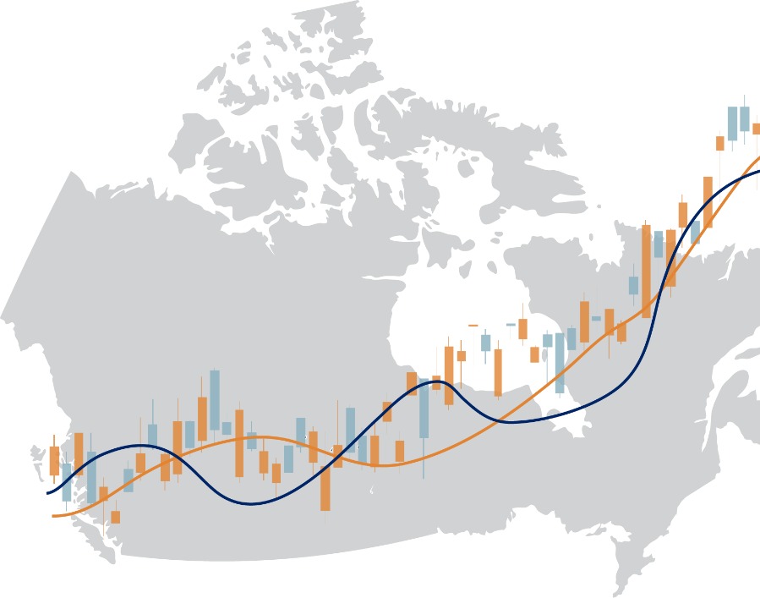
Measuring the Markets – Group Exercise
PART 5
In comparison to other exchanges around the world, Canada’s S&P/TSX Composite Index is best known for what types of stocks?
A
Blue Chip Stocks
B
Beef and Back Bacon (BBBs) Stocks
C
Mining and Energy (Resource) Stocks
D
High Priced Pharmaceutical Stocks
ANSWER
C. Mining and Energy (Resource) Stocks
Notes:
ALLOW AUDIENCE A FEW MINUTES TO READ QUESTION (Jeopardy music will play for 30 seconds. To stop and proceed to answer, hit ENTER.)
Once again, let’s play Jeopardy!
In comparison to other exchanges around the world, what types of stocks is Canada’s TSX index best known for?
Blue Chip Stocks
Beef and Back Bacon (BBBs) Stocks
Mining and Energy (Resource) Stocks
High Priced Pharmaceutical Stocks
The answer is – C, Mining and Energy (Resource) Stocks.
Because of our geography and natural resources, Canada’s markets are home to a number of junior miners and resource firms.

Slide 23





Investment Vehicles
PART 6
Mutual Fund
Pool of funds collected from many investors for the purpose of actively investing in the debt and equity markets. Gives small investors access to a professionally managed portfolio.
Index Fund
Operates the same way as a mutual fund, but replicates the performance of a given index or basket of securities. Relatively inexpensive because they buy and hold rather than trade (cheaper to operate).
Exchange Traded Fund (ETF)
Operate similar to a mutual fund or index fund but instead of buying into the fund, you actually purchase shares of the fund on a stock exchange. ETFs can be bought and sold throughout the day unlike mutual and index funds.
Segregated Fund
Operate the same way as a mutual fund, but are insurance contracts sold through insurance companies. Typically more expensive given the additional protection features and guarantees offered.
Mutual Fund
Notes:
Previously, we learned about the major asset classes – stocks, bond, and cash – and why they may be attractive to investors looking to balance risk and inflation against income and capital gains.
So now, with both an understanding of asset classes and the markets, you now have the basic building blocks to better understand how investors can participate in the markets by using financial products or investment vehicles.
Investment funds are a collection of investments or a pool of one or more asset classes.
Each fund can focus on specific themes or types of investments, such as government bonds, stocks from large companies, stocks from certain countries, or a mix of stocks and bonds (e.g. a balanced fund).
The most common types of investment funds categories are:
Mutual Funds:
These are pools of funds collected from many investors for the purpose of actively investing in the debt and equity markets, and they offer small investors access to professionally managed portfolios.
Index Funds:
Index funds operate the same way as a mutual fund, but they replicate the performance of a given index or basket of securities.
They are relatively inexpensive because they buy and hold rather than trade (cheaper to operate).
Exchange Traded Funds (ETFs):
ETFs operate similar to a mutual fund or index fund, but instead of buying into the fund, you actually purchase shares of the fund on a stock exchange.
They can be bought and sold throughout the day unlike mutual and index funds which only trade once throughout the day.
Segregated Funds:
Segregated funds operate the same way as a mutual fund but are insurance contracts sold by insurance companies.
Typically, they are sold at a higher cost given they generally offer additional features such as protection against losses and creditors.
OR – FOR PRESENTERS NOT COVERING ALL MODULES
Stocks, bonds and cash are the three major asset classes which can be attractive to investors looking to balance risk and inflation against income and capital gains.
With both an understanding of asset classes and now the markets, the basic building blocks are in place to better understand how investors can participate in the markets by using financial products or investment vehicles.
Investment funds are a collection of investments or a pool of one or more asset classes.
Each fund can focus on specific themes or types of investments, such as government bonds, stocks from large companies, stocks from certain countries, or a mix of stocks and bonds (e.g. a balanced fund).
The most common types of investment funds categories are:
Mutual Funds:
These are pools of funds collected from many investors for the purpose of actively investing in the debt and equity markets, and they offer small investors access to professionally managed portfolios.
Index Funds:
Index funds operate the same way as a mutual fund, but they replicate the performance of a given index or basket of securities.
They are relatively inexpensive because they buy and hold rather than trade (cheaper to operate).
Exchange Traded Funds (ETFs):
ETFs operate similar to a mutual fund or index fund, but instead of buying into the fund, you actually purchase shares of the fund on a stock exchange.
They can be bought and sold throughout the day unlike mutual and index funds which only trade once throughout the day.
Segregated Funds:
Segregated funds operate the same way as a mutual fund but they are sold by insurance companies.
Typically, they are sold at a higher cost given they generally offer additional features such as maturity guarantees, death benefit guarantees and protection against losses and creditors.

Slide 24




Investment Funds – Overview
PART 6
Give it back
Generate returns
INVESTMENT FUNDS
GIC
EQUITY/DEBT SECURITIES
INVESTORS
Invests in
Pool their money
Note: for illustration purposes only; investment fund returns are not guaranteed.
Notes:
Now, before we take a closer at each of the types of investment funds, let’s look at the lifecycle of an investment fund and some key terminology related to investment funds.
In general terms, investment funds are pools of money provided by individual investors, companies, and other organizations, and the pools of money are held in trust on their behalf.
The money is used to buy a portfolio of investments (e.g. stocks, bonds and other funds) based on a stated investment goal.
The investments in the investment fund are managed by a team of financial professionals called portfolio managers (also known as Money Managers).
Portfolio managers make the day-to-day decisions as to what to buy and sell on behalf of the fund, following a specific investment mandate (formal guidelines around risk and return objectives).
An investment fund can focus on specific types of investments (e.g. government bonds, large cap domestic stocks, or foreign stocks) or it can invest in a combination of assets.
Investors in a fund are called unitholders because they purchase units in a professionally managed portfolio of securities, with each unit representing a share of ownership in the pool.
Investment funds are widely available through banks, financial planning firms, investment firms, credit unions and trust companies.
These providers make their money through management fees charged to unitholders.
The net asset value (NAV) of an investment fund is the total sum of the market value of all the equity/debt securities held in the portfolio including cash, less the liabilities, divided by the total number of units outstanding.
The NAV is effectively the dollar value of one unit of the fund.
Investment funds deliver returns by investing each unitholders' money to earn dividends or interest, and by selling these investments at a higher price than originally paid (note: there is no guarantee of returns).
Profits or losses get shared across all investors in proportion to their individual investment in the fund.
Depending on the type of investment fund, any money (such as interest income from bonds) earned from a fund's investments is paid out to unitholders as income distributions, while any profits from selling these investments at higher prices are generally paid out as capital gains distributions at year-end.
The individual unitholders can also make a capital gain or capital loss when selling their units, depending on whether the unit price has increased or decreased since the units were purchased.

Slide 25

Investment Vehicles – Mutual Funds
PART 6
Segregated Fund
GIC
Exchanged Traded Fund
Mutual Fund
Notes:
By far, mutual funds own the lion’s share of investors money when it comes to investments funds.
Part of their attraction is that mutual funds provide easy and affordable access to a variety of investments held in the fund.
Relatively low initial investment minimums (sometimes as low as $500) and sales documentation, such as the mutual fund prospectus and fund facts, are intended to provide timely and transparent information about the investment strategy and potential risks of investing in the fund.
Because of their broad appeal, mutual funds are available for:
Core asset classes, alternative asset classes and niche products (e.g. infrastructure).
Regional, country and sector approaches
A variety of investment styles including growth, value, core, growth at a reasonable price (GARP) and momentum, and/or a combination of all above.
Portfolio manager specific approaches to investing
Important to always keep in mind is that you cannot predict how a fund with perform in the future.
Past performance should never be used as an indication for future returns, but it can give you an idea of how the fund has performed relative to various market conditions and how the fund compares to:
Other funds with the same investment objective (e.g. a peer group); and
A relevant benchmark – a benchmark is a market or sector index against which the performance of the investment fund can be compared.
OPTIONAL COMMENTARY - To learn more about mutual funds, please refer to the supplemental handout in your packages.
FOR PRESENTERS: INTERNAL LINK TO SUPPLEMENTAL HANDOUT – Mutual Funds: What Are They?:
http://advisornet.fg.rbc.com/wealthmanagementservices/file-901008.pdf

Slide 26
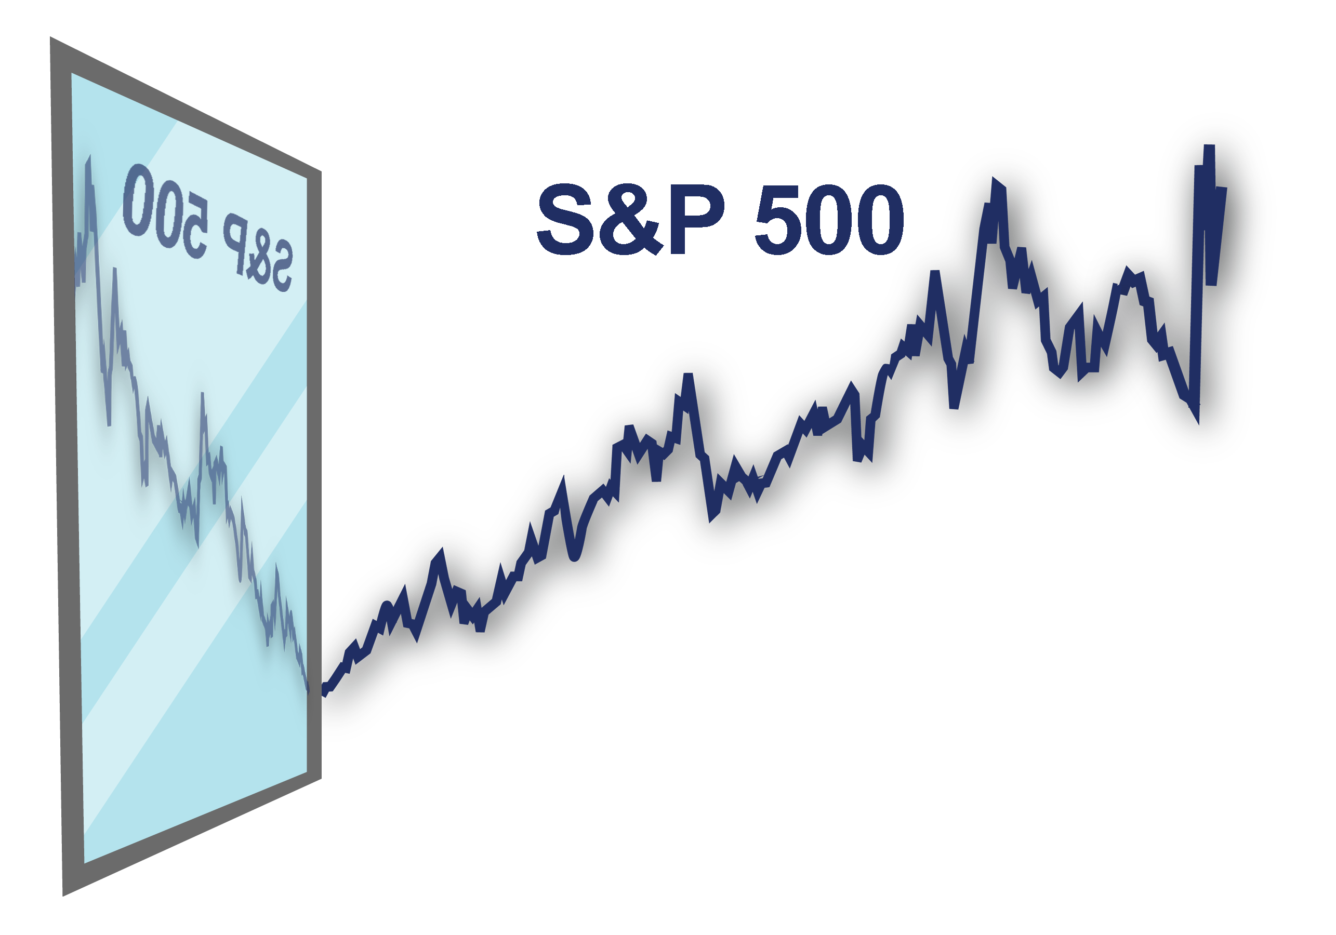
Investment Vehicles – Index Funds
PART 6
Index
Notes:
While the investment objective of most mutual funds is to outperform a benchmark through some combination of higher return or less volatility than a benchmark index, index funds seek to mirror or track the returns and volatility of the various stock or bond indices.
Portfolio managers of mutual funds spend a lot of time researching and thinking about decisions around asset classes, credit quality, sector exposure, price and the underlying characteristics of the securities they are buying or selling.
These portfolio managers are known as active managers.
Conversely, the portfolio managers of index funds spend substantially less time in their decision-making process around issues of security selection.
Because they are only trying to replicate the makeup of the index, these portfolio managers are described as passive managers.
Understanding the difference between the active and passive approaches to investing is important because it impacts expectations around risk and reward, and the cost of investment management.
Typically, in the case of active management, more personnel and analytical resources are required to manage the portfolio, therefore, the cost of management – as measured by the management expense ratio or MER – is higher than a comparable index fund in the same asset class.
OPTIONAL COMMENTARY – In module #15, Understanding Fees, we will explore how to read a fund fact sheet and take a closer look at the composition of an MER.

Slide 27

Investment Vehicles – Exchange Traded Funds (ETFs)
PART 6
Creation and redemption can be made
Commonly tracks on index
Most are passively managed
Unitized with NAV/unit quotes
Characteristics of ETFs
Traded intraday
on an
exchange
Exposure to basket of securities
Open ended
Notes:
Now that you are familiar with mutual funds and index funds, let’s turn our attention to Exchange Traded Funds or ETFs.
While mutual fund’s do hold the lion’s share of investment dollars, ETFs are the fastest growing category of investment funds.
ETFs provides many of the same advantages of mutual funds, however, they are typically easier to buy and sell, and generally have lower management fees.
Just like a mutual fund, an ETF offers instant portfolio access to dozens, even hundreds, of stocks or bonds.
However, instead of buying the fund through an adviser and waiting several days for the transaction to finalize or settle, you can buy an ETF instantly on the market, just like a stock – they even have ticker symbols.
Traditional ETFs also differ from mutual funds in that their managers do not choose the individual stocks or bonds in an attempt to beat the market.
Instead, they follow indexes or specific strategies that are designed to give investors the returns of overall market segment.
Similar to index funds, this means that your risk and return should not deviate from the underlying benchmark by much, and it helps keep the cost of ETFs low.

Slide 28


Investment Vehicles – Segregated (Seg.) Funds
PART 6
MUTUAL FUNDS
SEGREGATED FUNDS
 | Investment product offering a growth opportunity
 | Offers a maturity guarantee on all or a portion of the investment
 | Allows resets to lock in investment gains
 | Provides a death benefit guarantee
 | Can be passed to heirs without probate fees
 | Provides potential protection from creditors
Yes
Yes
No
Yes
No
Yes
No
Yes
No
Yes
No
Yes
Notes:
We take an in depth look at segregated funds (or Seg. Funds) in a subsequent ‘Insurance’ lesson, so today we will just touch on the primary differences to mutual funds.
Segregated funds are an insurance contract sold by insurance companies, combining the growth potential of investment funds with insurance protection.
Unlike mutual funds, segregated funds offer a maturity guarantee to protect all, or a portion of the money invested, typically between 75% and 100% of the original investment.
So even if the underlying fund loses money, investors are guaranteed to get back some, or all of their principal investment.
The caveat is that investors must hold their investment for a certain length of time (usually 10 years) in order to benefit from the guarantee.
Redeeming before the maturity date voids the guarantee.
The investor would simply get current market value less any fees (may be more or less than what was originally invested).
Investors will also pay higher MER for this insurance protection.
Other benefits of segregated funds include:
Resets to lock in investment gains
Death benefit guarantees
Asset transfer to heirs without probate fees
And potentially, creditor protection.
OPTIONAL COMMENTARY – More on segregated funds in module #17, Insurance.

Slide 29

Investment Vehicles – Group Exercise
PART 6
Which of the following options is least likely to be an investment style for an investment fund?
A
Indexing
B
Country Specific
C
Sector Specific
D
Passive Aggressive
ANSWER
D. Passive Aggressive
Notes:
ALLOW AUDIENCE A FEW MINUTES TO READ QUESTION (Jeopardy music will play for 30 seconds. To stop and proceed to answer, hit ENTER.)
Our last quiz of the day!
Which of the following options is least likely to be an investment style for an investment fund?
Indexing
Country Specific
Sector Specific
Passive Aggressive
The answer is – D, Passive Aggressive.

Slide 30


Contact Us
Nowochin Wealth Management
Charles Nowochin
Charles.Nowochin@rbc.com 403-341-7996
Melissa Rhodes melissa.rhodes@rbc.com 403-341-7407
Notes:
And that bring us to the end of today’s lesson.
Any questions?
Please feel free to reach out to me or a member of my team to discuss any questions you may have.
In the next lesson, Wealth Stage Plans, we will walk through a case study of a multi-generational family.
We will demonstrate how planning needs differ across the three wealth stages you learned about in this lesson: ‘Early Saver’, ‘Mid-Life Accumulator’ and ‘Preserver/Spender’.
It will be held on _____________________________, so please watch for an invitation and contact any one of us to register.
Thank you!
OR
And that bring us to the end of our lesson on ‘Planning Benefits’.
Any questions before we move on to our case study illustration for ‘Wealth Stage Plans’ in module #8?
Ok, we will take a short break, and then we will walk through a case study of a multi-generational family.
In the case study, we will demonstrate how planning needs differ across the three wealth stages you just learned about:
the ‘Early Saver’ – role played by a Millennial.
the ‘Mid-Life Accumulator’ – role played by a Generation X’er.
and the ‘Preserver/Spender’ – role played by a Baby Boomer.
Thank you!

Slide 31


Key ‘Investment Funds’ Terminology
APPENDIX 1
Portfolio Manager | Also known as a Money Manager. The team of investment professionals responsible for making the day-to-day buy and sell decisions in accordance with the investment fund’s stated objective.
Investment Mandate | Formal guidelines around risk and return objectives the money manager follows when choosing the investments for the portfolio.
Benchmark | A market or sector index against which the performance of the investment fund can be compared.
Net Asset Value (NAV) | The total sum of the market value of all the securities held in the portfolio including cash, less the liabilities, divided by the total number of units outstanding.
Management Expense Ratio (MER) | The percentage fee mutual funds pays annually to the management company for managing the fund and it’s investments, plus operating costs.
Notes:
What is a Portfolio Manager, also referred to as a Money Manager?
A team of investment professionals responsible for making the day-to-day buy and sell decisions in accordance with the investment fund’s stated objective.
Investment Mandate refers to the formal guidelines around risk and return objectives the money manager follows when choosing the investments for the portfolio.
Benchmark is a market or sector index against which the performance of the investment fund can be compared.
Net Asset Value (NAV) is the total sum of the market value of all the securities held in the portfolio including cash, less the liabilities, divided by the total number of units outstanding.
And lastly, the Management Expense Ratio (MER).
The MER is the percentage fee mutual funds pays annually to the management company for managing the fund and it’s investments, plus operating costs.

Slide 32
Thank you
This presentation has been prepared for use by the RBC Wealth Management member companies, RBC Dominion Securities Inc. (RBC DS)*, RBC Phillips, Hager & North Investment Counsel Inc. (RBC PH&N IC), RBC Global Asset Management Inc. (RBC GAM), Royal Trust Corporation of Canada and The Royal Trust Company (collectively, the “Companies”) and their affiliates, RBC Direct Investing Inc. (RBC DI)*, RBC Wealth Management Financial Services Inc. (RBC WMFS) and Royal Mutual Funds Inc. (RMFI). *Member–Canadian Investor Protection Fund. Each of the Companies, their affiliates and the Royal Bank of Canada are separate corporate entities which are affiliated. “RBC advisor” refers to Private Bankers who are employees of Royal Bank of Canada and licensed representatives of RMFI, Investment Counsellors who are employees of RBC PH&N IC and the private client division of RBC GAM, Senior Trust Advisors and Trust Officers who are employees of The Royal Trust Company or Royal Trust Corporation of Canada, or Investment Advisors who are employees of RBC DS. In Quebec, financial planning services are provided by RMFI or RBC WMFS and each is licensed as a financial services firm in that province. In the rest of Canada, financial planning services are available through RMFI, Royal Trust Corporation of Canada, The Royal Trust Company, or RBC DS. Estate and trust services are provided by Royal Trust Corporation of Canada and The Royal Trust Company. If specific products or services are not offered by one of the Companies or RMFI, clients may request a referral to another RBC partner. Insurance products are offered through RBC WMFS, a subsidiary of RBC DS. When providing life insurance products in all provinces except Quebec, Investment Advisors are acting as Insurance Representatives of RBC WMFS. In Quebec, Investment Advisors are acting as Financial Security Advisors of RBC WMFS. The strategies, advice and technical content in this publication are provided for the general guidance and benefit of our clients, based on information believed to be accurate and complete, but we cannot guarantee its accuracy or completeness. This publication is not intended as nor does it constitute tax or legal advice. Readers should consult a qualified legal, tax or other professional advisor when planning to implement a strategy. This will ensure that their individual circumstances have been considered properly and that action is taken on the latest available information. Interest rates, market conditions, tax rules, and other investment factors are subject to change. This information is not investment advice and should only be used in conjunction with a discussion with your RBC advisor. None of the Companies, RMFI, RBC WMFS, RBC DI, Royal Bank of Canada or any of its affiliates or any other person accepts any liability whatsoever for any direct or consequential loss arising from any use of this report or the information contained herein. ® Registered trademarks of Royal Bank of Canada. Used under license. © 2019 Royal Bank of Canada. All rights reserved.

